Slide 1
Parallel GET and PUT in UNISON
Betis Baheri, Paul Bryant, Alfred Shaker

Slide 2
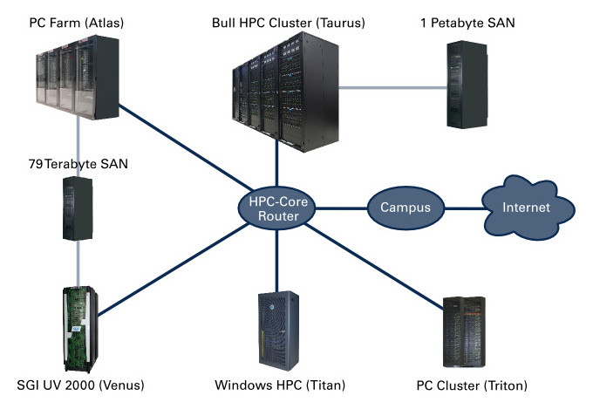
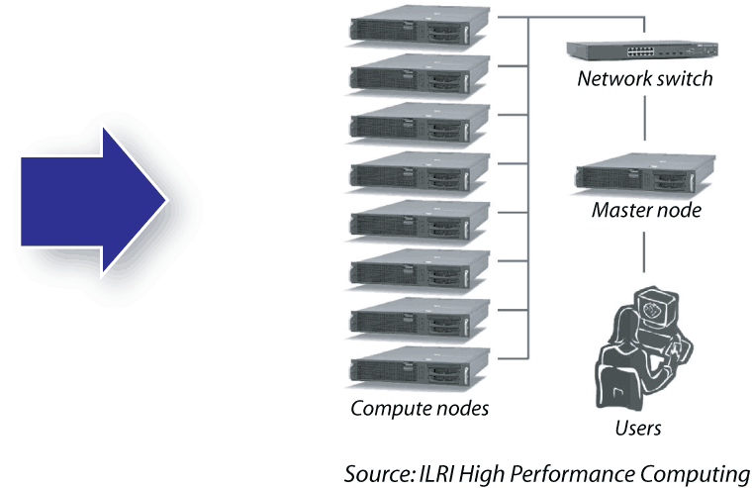
Introduction

Slide 3
Scope
Problem:
Although unison provides a nice environments to get or put files between different HPC systems, transferring in single connection stream is a bottleneck.
Possible approaches:
Build a low level service and parallel get and put ( requires root)
Build a management system to control and act as a mgs between HPCs

Slide 4
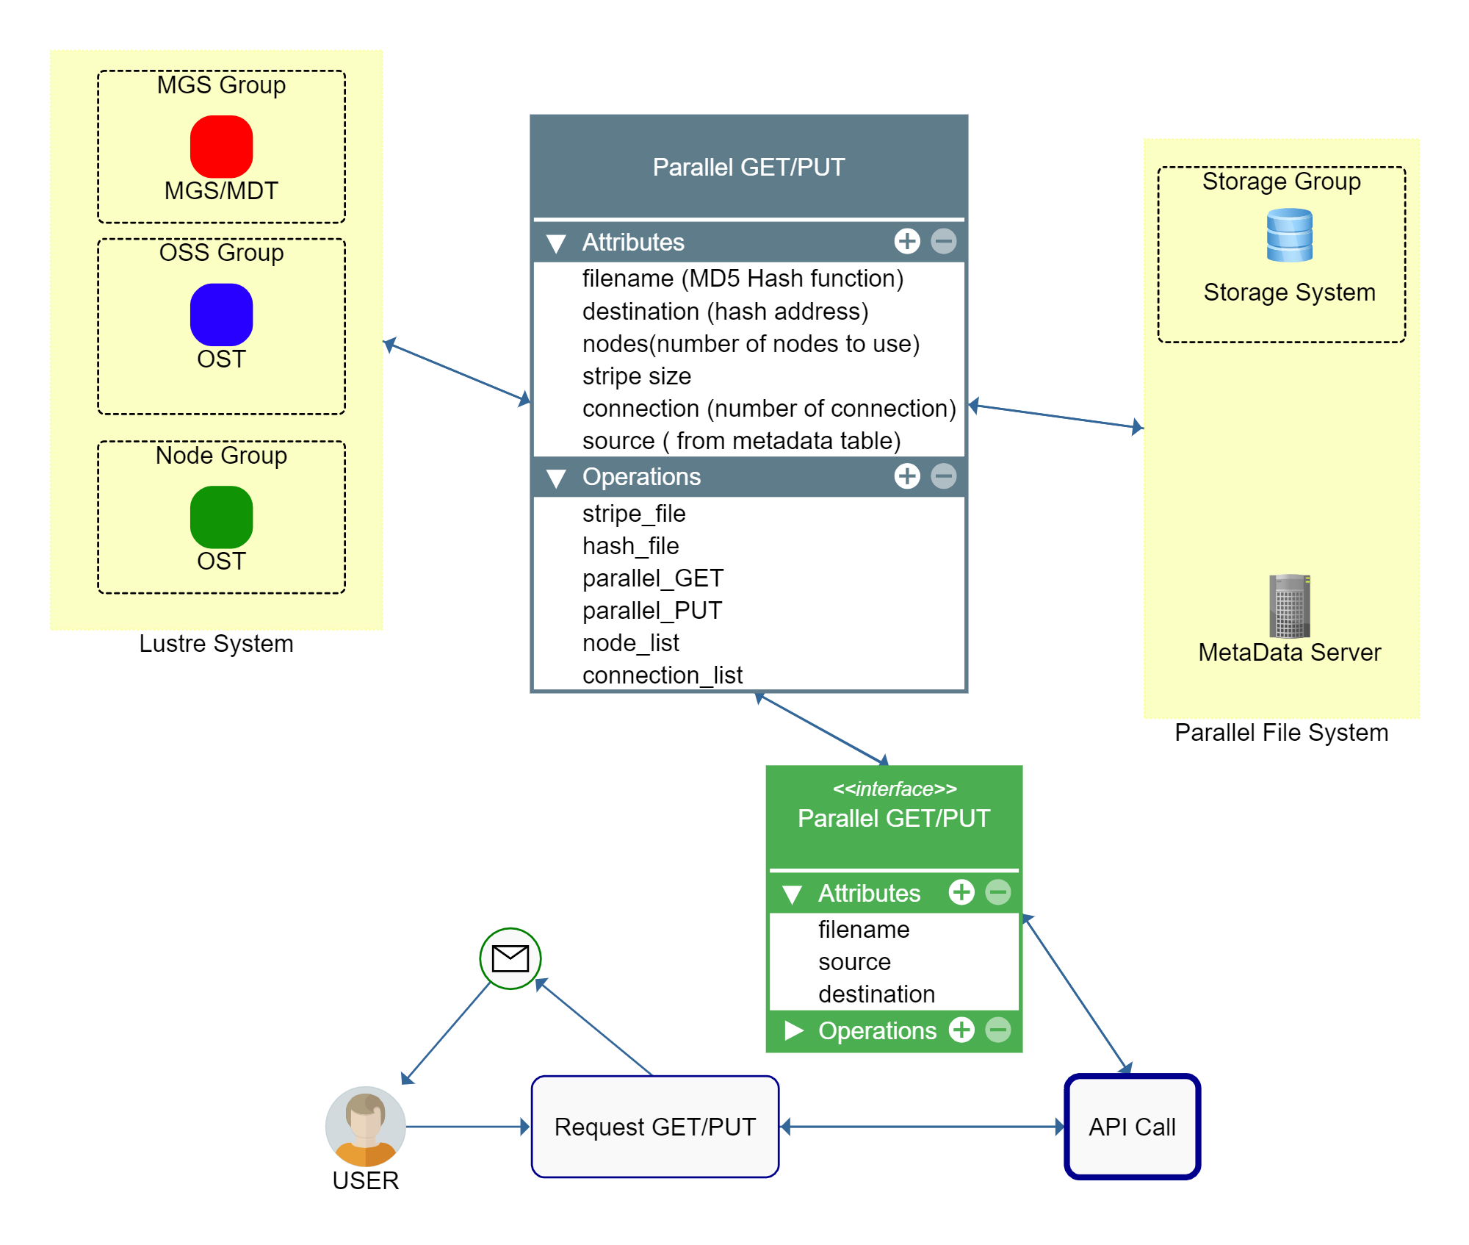
Our Approach
MGS system with capability of running multiple connection between HPCs system and PUT or GET in Parallel

Slide 6
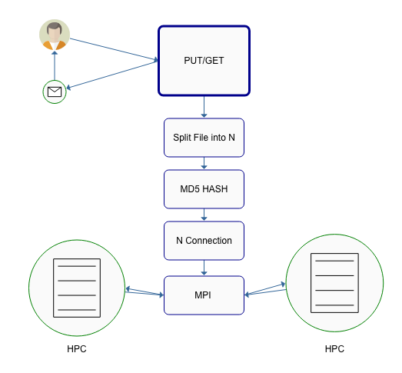
Overall Process

Slide 7
Requirments
Linux OS (tested on Linux, other systems may not function)
Mounted Lustre filesystem
Google Cloud (required)
Account with access to Google Cloud Storage (Storage Admin)
Cloud SDK - https://cloud.google.com/sdk
Service account and local credentials (json)
AWS (optional)
Account with access to S3
Access Keys/Codes (~/.aws/credentials)

Slide 8
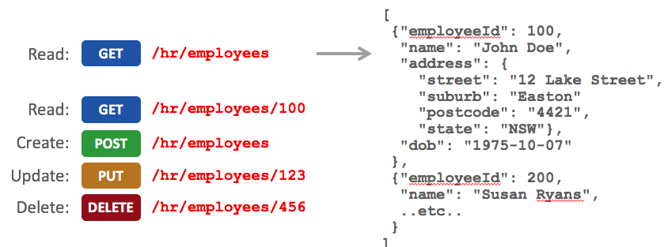
Restful GET PUT

Slide 9
POST
Meta-Data
POST
Resource: \meta
Argument: {json: ?}
Notes: There is very little in the way of error checking, insure that keys match up with database.
$ curl 127.0.0.1:5000/meta -X POST -d '{"objectID":"example","parallelLoc":"/var/tmp","cloudLoc":"test","verificationHast":"a12b","cloudVendor":"gcloud"}'
This will attempt to post the following information to the supporting database:
{ "objectID":"example", "parallelLoc":"/var/tmp", "cloudLoc":"test", "verificationHast":"a12b", "cloudVendor":"gcloud" }
{"true": "Successfully POST object example"}

Slide 10
GET
GET
Resource: \meta\{objectID}
Arguments: None
$ curl 127.0.0.1:5000/meta
This will provide a list of all available parents
{"valid_parent_ids": ["example"]}
curl 127.0.01:5000/meta/example
Will return information relating specifically to that objectID
{ "main": { "objectID": "example", "parallelLoc": "/var/tmp", "cloudLoc": "test", "verificationHash": null, "parentID": null, "time": "2018-12-06 02:01:32", "cloudVendor": "gcloud" } }

Slide 11
DELETE
DELETE
Resource: \meta\{objectID}
Arguments: None
$ curl 127.0.0.1:5000/meta -X DELETE
Calling DELETE for metadata without supplying a objectID
{"ERROR": "No objectID supplied"}
$ curl 127.0.0.1:5000/meta/invalid -X DELETE
Attempting to DELETE a non-existent object results in an error.
{"False": "Error: Unable to identify invalid"}
$ curl 127.0.01:5000/meta/example -X DELETE
This will remove the object from the database but NOT the data, this will only affect the meta data database.
{"True": "Success: Removed example"}

Slide 12
PUT
Resource: \meta
Argument: backup=<bool> & restore=<bool>
$ curl 127.0.01:5000/meta -X PUT
{"error": "backup or restore must be declared"}
The process requires use of the associate boolean arguments, for instance.
$ curl 127.0.01:5000/meta -X PUT -d "backup=True"
{"success": "database backup"}
You will then find the database under the (default) db_backup_advdb18 bucket

Slide 13
Parallel PUT GET
GET
Resource: /parallel/{objectID}/{targetFileLocation}
Arguments: newObjID=<string> & removeAfter=<bool>
PUT
Resource: /parallel/{objectID}/{targetFileLocation}
Arguments: split=<int> & join=<int> & newObjID=<string> & removeAfter=<bool>
Notes:
Attempting to add additional functionality via new arguments (not listed above)
stripeSize
stripeCount

Slide 14
Cloud
GET
Resource: /cloud/{objectID}/{cloudVendor}/{cloudLoc}
Arguments: newObjID=<string> & removeAfter=<bool>
PUT
Resource: /cloud/{objectID}/{cloudVendor}/{cloudLoc}
Arguments: newObjID=<string> & removeAfter=<bool>

Slide 15
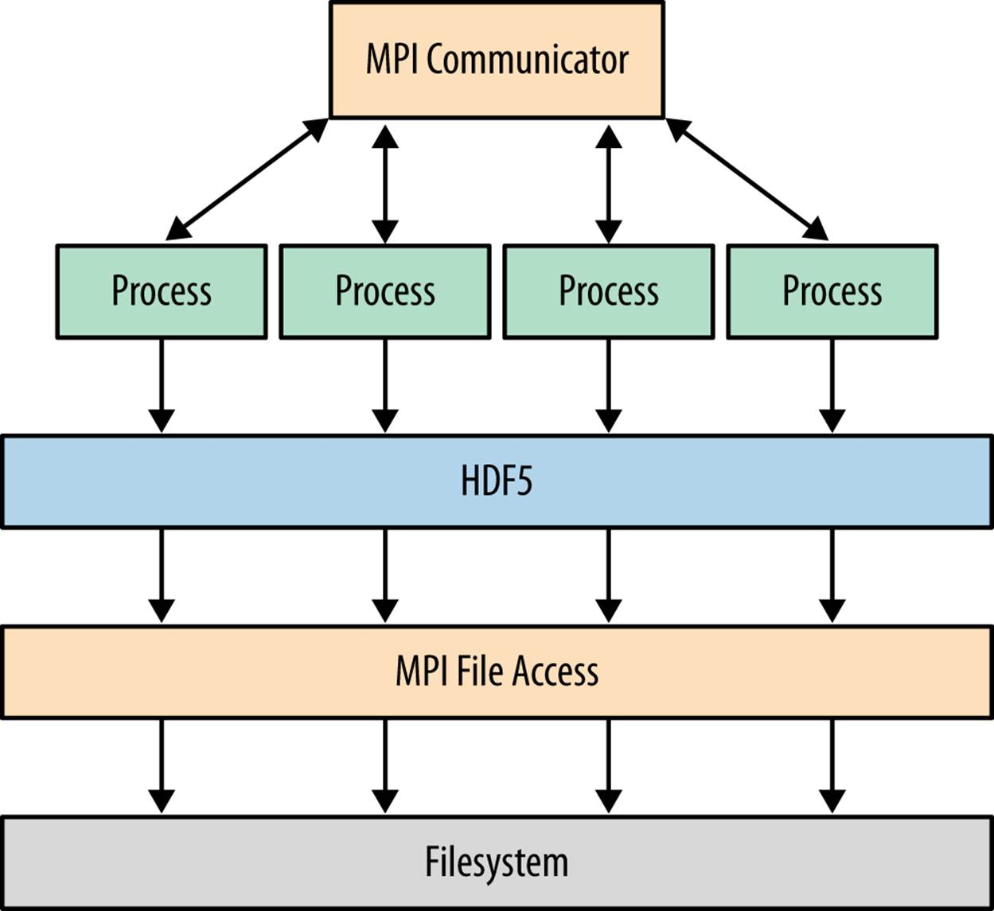
Calling MPI as external command
To provide the maximum use of resources and execute GET and PUT in parallel we split the code into multiple classes and then run each part as a new instance in MPI

Slide 16
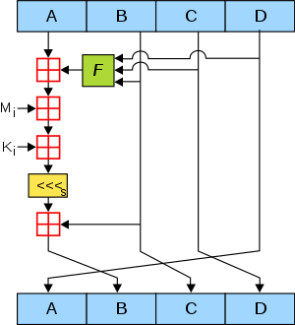
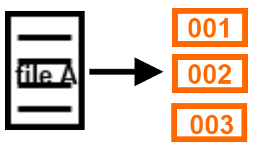
MD5 Hash and Splitting
Preserves the integrity
easy to check against original file
If any spliced parts gets corrupted using CRC is restorable

Slide 17
Database
HPC Scientific workflows
Cloud Scientific workflows
LAN: HPC+PFS
HPC Scientific workflows
Unison Protoype
WAN: Cloud Computing + Object Storage
Big Data Scientific workflows

Slide 18
Database
HPC Scientific workflows
Cloud Scientific workflows
LAN: HPC+PFS
HPC Scientific workflows
Database ???
WAN: Cloud Computing + Object Storage
Big Data Scientific workflows

Slide 19
Database
Core to providing uniform approach to data management across systems
Current setup address basic management requirements
Identifications, Cloud Locations, Parallel Storage …
Expansion required to support the further development
Hierarchal data management
Capture additional meta data (over head would be minimal)

Slide 20
Conclusion
Parallel GET and PUT parallel will be increase the usage of network throughput
Using MD5 hash function not only make it easy to check also, makes it easy to rebuild the Metadata server in case of data loss
MPI makes it possible to not only utilize the network throughput also, it utilizes processors and resources in management server
Controllable record of data locations and potential for increased flexibility

Slide 21
Questions?

